Slide 1

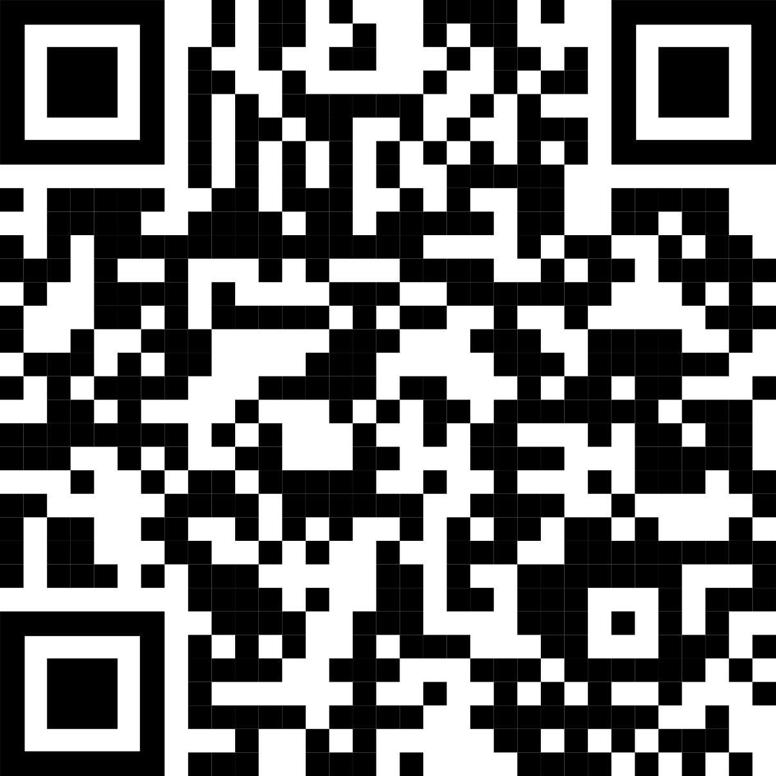
The ranking task can provide additional information regarding a suspect’s likelihood of guilt or innocence.
Non-Cognitive Predictors of Student Success: A Predictive Validity Comparison Between Domestic and International Students
Non-Cognitive Predictors of Student Success: A Predictive Validity Comparison Between Domestic and International Students
Title: Subtitle
Kym McCormick, Carolyn Semmler, John C. Dunn
AMMO BAR
Delete this and replace it with your…
Extra Graphs
Extra Correlation tables
Extra Figures
Extra nuance that you’re worried about leaving out.
Keep it messy! This section is just for you.
INTRO
Just give context for the gap you’re filling
You’re not going to get yelled at if you don’t cite the 5 papers from 1937 that defined this construct. This aint no lit review. They’ll download your paper if they want that.
METHODS
Measures you collected.
What you tested for (i.e., the predictor and outcome relationships you looked for).
Statistical techniques you used.
RESULTS
Ideally a graph, if you have one. NBD if you include your money-graph in both sidebars.
Listing specific relationships you found is clearer than trying to summarize the results overall. But doing both is fine too.
DISCUSSION
“If this result actually generalized and I didn’t have to humbly disclaim the possibility of a thousand confounds and limitations, it would imply that….”
Fill this space up as much as you need to, and feel free to include essential figures and table-data but keep it skimmable. You can make this bar slightly wider if you need to, but don’t squish the middle too much. The middle is more important than this bar.
Take a picture to download further information
Notes:
Notes:
In Powerpoint, click View > Guides
Keep text within gutter guides.
Author list: Don’t split names onto two lines (e.g., “Jimmy [break] Smith”). If that happens, use a new line, unless you need the space. Bold the first names of anybody who’s presenting in person.
Intro/methods/result: Do not drop below font size 28, but if you have extra space, jack up the font size until the space is full.
Do not use color in the sidebars except in graphs/figures. It’ll pull attention from the center and slow interpretation for passersby.

Slide 2
Color Palette
Theory
Empirical
Methods
Intervention
Any dark blue works.
This one is…
R = 26
G = 35
B = 126
Any dark green works.
This one is…
R = 0
G = 77
B = 64
Any dark red works.
This one is…
R = 140
G = 22
B = 22
Any gold-yellow works.
This one is…
R = 255
G = 213
B = 79

Slide 3
FAQ
How do I create a QR code?
https://www.qrcode-monkey.com/
https://www.qrstuff.com/
What if my intro/methods/results doesn’t fit in the silent bar?
If you’re trying to put so much into that bar that it doesn’t fit, they won’t have time to read it anyway. First try moving stuff to the ammo bar. Next, cut cut cut.
Instead of trying to fill space, you’re trying to conserve space.
What if I have a really important graph or picture?
Move the QR Code to the Silent Presenter, then put your graph/image in the middle.

Slide 4

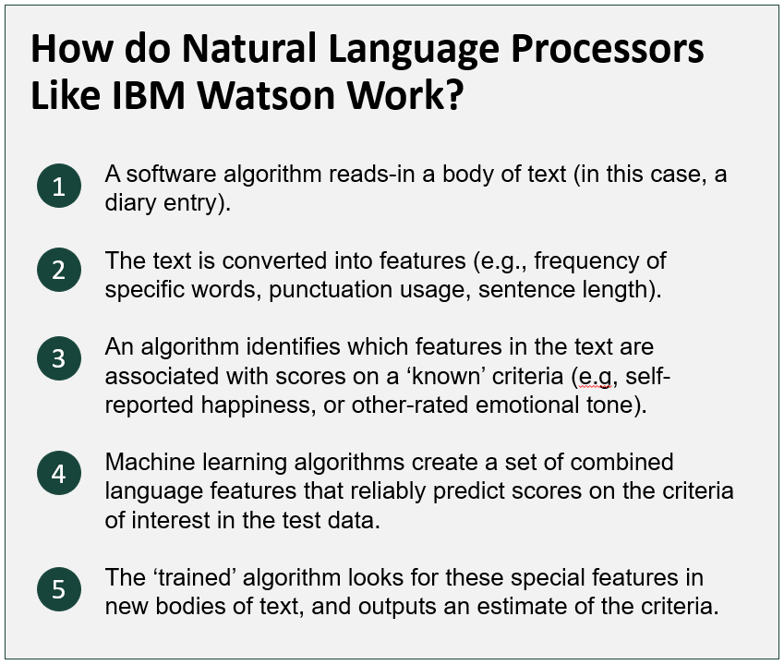
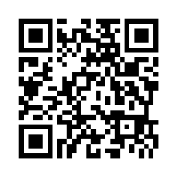

IBM Watson can accurately detect joy and sadness in samples of written language.
Non-Cognitive Predictors of Student Success: A Predictive Validity Comparison Between Domestic and International Students
Non-Cognitive Predictors of Student Success: A Predictive Validity Comparison Between Domestic and International Students
How Are You Feeling Today, Dave? Using IBM’s Watson Supercomputer to Extract Emotions from Natural Language
 | Watson Happiness | Watson Sadness
Self-report Happiness | .21** | -.22**
Self-report Distress | ns | .19*
Self-report Conflict Management | ns | -.24*
Self-report Physical Activity | .19** | -.25**
Mike A. Morrison
INTRO
IBM Watson is a supercomputer able to process naturally written language. It can reportedly read a body of text, and extract from that the emotions that the author was feeling when they wrote it.
This study compared Watson's ratings of emotional tone in text to self-report ratings, using a sample of crew members participating in NASA analog science mission in Antarctica.
METHODS
Participants: N = 6 crew members participating in a NASA Science Mission in Antarctica. T = 42 (average) mission days per crew member
Diaries: Crew members wrote freeform in daily diaries each day . Diaries typically discuss activities from the day, and other crew members.
Self-Reports: Crew members completed self-report measures of psychological distress, happiness, conflict management, and physical activity.
Using Watson’s Alchemy Language service, Watson analyzed diary text and reported estimates of Fear, Joy, Sadness, Anger, and Disgust in each diary entry.
Analysis: I tested for significant correlations between Watson's measures of Fear, Joy, Sadness, Anger, and Disgust against a battery of self-report measures of daily attitudes.
RESULTS
Watson’s estimates of happiness and sadness correlate significantly with related self-report measures, but Watson’s estimates of disgust, fear, and anger showed no significant correlations.
Participants:
N = 6 crew members participating in a Science Mission in Antarctica
T = 42 (average) mission days per crew member
Notes:
Example adding an image to a poster

